Slide 1
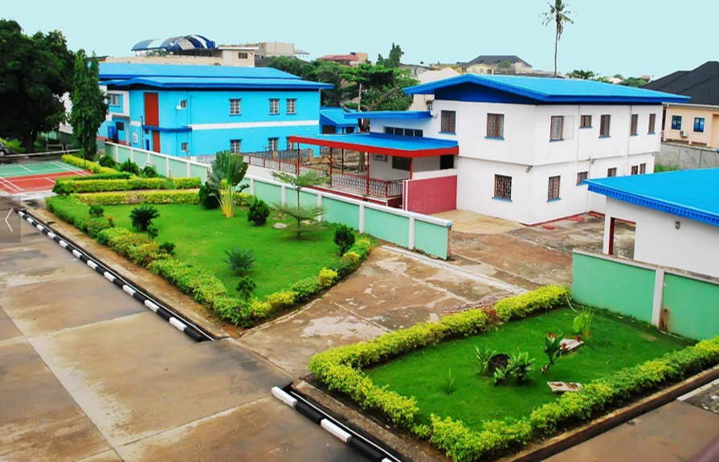

Computational Science and Numerical Methods (CSC 317)
www.trinityuniversity.edu.ng
Omosebi Paul Adeoye
08035854547
ade.omosebi@trinityuniversity.edu.ng

Slide 2

O.R. AS AN ADAPTATION OF THE SCIENTIFIC APPROACH
Operations Research is most fundamentally science-based.
It is so by adoption and adapting the scientific approach in analysing operational decision problems. (These are problems involved in carrying out operations).

Slide 3
O.R. AS AN ADAPTATION OF THE SCIENTIFIC APPROACH
1. Definition of Problem
This involves the development of a clear and concise statement of the problem at hand. This gives direction and meaning to other steps.
The whole system be examined critically in order to recognize all the areas that could be affected by any decision taking. It is essential to examine the symptoms and true causes of the problem when defining the issue.

Slide 4
O.R. AS AN ADAPTATION OF THE SCIENTIFIC APPROACH
2. Construction of a Model
This step involves the construction of a suitable model (usually mathematical), which is a representation of the problem at hand.
It might be of a functional nature as in linear programming or have a logical structure as in simulation and algorithms.

Slide 5
O.R. AS AN ADAPTATION OF THE SCIENTIFIC APPROACH
Example
Minimize: C = 4x + 5y
Subject to: x + 3y ≥ 6
x + y ≥ 3
x , y ≥ 0 , which is a linear programming model.

Slide 6
O.R. AS AN ADAPTATION OF THE SCIENTIFIC APPROACH
3. Data Collection
It involves obtaining quantitative data either from existing records or a new survey that fits well into the constructed model of the problem.

Slide 7
O.R. AS AN ADAPTATION OF THE SCIENTIFIC APPROACH
4. Developing a Solution
Manipulation of the model to arrive at the best (optimal) solution to the problem.
Solving some mathematical equations for optimal decisions as in calculus or linear programming models. It may also be a logical approach or a functional approach which does not require solving a mathematical equation, such as in queuing theory.

Slide 8
O.R. AS AN ADAPTATION OF THE SCIENTIFIC APPROACH
5. Testing the Model and its Solution
This involves determining the accuracy or the completeness of the data used in the model because inaccurate data leads to inaccurate solutions. If the model can adequately predict the effect of the changes in the system, however simple it may be, it is acceptable.

Slide 9
O.R. AS AN ADAPTATION OF THE SCIENTIFIC APPROACH
6. Interpretation of the Results/Establishment of Controls
This involves determining the implication of the solutions to the system. In most cases, a solution to a problem will result in a kind of action or change in the organization. The implication of these actions or changes must be determined and analysed before results are implemented.

Slide 10
O.R. AS AN ADAPTATION OF THE SCIENTIFIC APPROACH
7. Implementation of Model
This is the process of incorporating the solution into the system, which is carried out by the personnel already working in the area and not the Operations Research team.
The solution to the problem has to be translated to a set of operating instructions which can be handled by the personnel involved.

Slide 11
FLOW CHART SHOWING THE STAGES IN OPERATIONS RESEARCH
Problem Definition
Model Construction
Input Data Acquisition
Solution Derivation
Testing of Model and Solution
Analyzing Results/Establishment of Control
Implementation of Results

Slide 12
ROLE OF OPERATIONS RESEARCH IN BUSINESS
Operations Research help to determines the information requirements that enable the best decisions to be made, subject to cost constraints and to formulation of rules or procedures for making these operating decisions. It is also concern with improving the day-to-day efficiency of a company’s operation.

Slide 13
ROLE OF OPERATIONS RESEARCH IN BUSINESS
Business areas where Operations Research is applicable include:
i. Stock re-ordering policies.
ii. Transport schedules.
iii. Product mix.
iv. Production flows.

Slide 14
ROLE OF OPERATIONS RESEARCH IN BUSINESS
v. Allocation problems i.e. which jobs should be allocated to which machines.
vi. Time wasted queuing at issuing, counters.
vii. Scheduling of activities in a complex project.
viii. General congestion problem.

Slide 15
LIMITATIONS OF OPERATIONS RESEARCH
i. It is often difficult to balance the requirement of reality and those of simplicity.
ii. The quality of data collection may be poor and/or inaccurate.
iii. In many cases, the solution of Operations Research problem is restricted by the lack of suitable solution techniques.

Slide 16
LIMITATIONS OF OPERATIONS RESEARCH
iv. The derived solution may be sub-optimal i.e. the boundaries of the problem may be open.
v. An Operations Research model is static but the solution it imitates is dynamics.
vi. Conflict between conclusion reached by the Operations Research analyst and the opinion of time managers as to the best course of action.

Slide 17
PRACTICAL USE OF COMPUTER IN OR
The computer as we all know is the major modern in information technology equipment.
One of its uses, which most people in our part of the world are not yet attuned to, is problem-solving. Operations research uses the computer in this regard.

